Slide 1
Impact of Internet Usage
· Davin Frankosky
· George Liberatos
· Alison Love
· Haylee McLean
· Quentin O’Neal
· Tia Scott

Slide 2

Project Outline
In the era of digital transformation, the internet has become an integral part of our daily lives, influencing how we communicate, work, learn, and entertain ourselves. The vast expanse of the digital landscape offers a rich tapestry of data, providing an opportunity to unravel the intricate patterns of internet usage across different regions, demographics, technology, and disparities of information.
This project aims to delve into the multifaceted aspects of internet usage, leveraging data analytics to gain insights into users of the internet, technological trends, and censorship of global connectivity.

Slide 3

Research Questions
Question 1
Who is using the internet?
What is the average gender, income, and educational level?
Question 2
What differences are between broadband and mobile usage?
Who is predominantly using broadband and mobile?
What are some of the disparities between broadband or mobile use?
Question 3
Who is censoring the internet to users?
What countries are affected the most by internet censorship?
When looking at censorship globally, who is being censored?

Slide 4
Data Analysis

Slide 5
Impact of Internet Demographics
· Alison Love
· Quentin O’Neal

Slide 6
Research Questions
Question 1
Who is using the internet?
What is the average gender, income, and educational level?

Slide 7
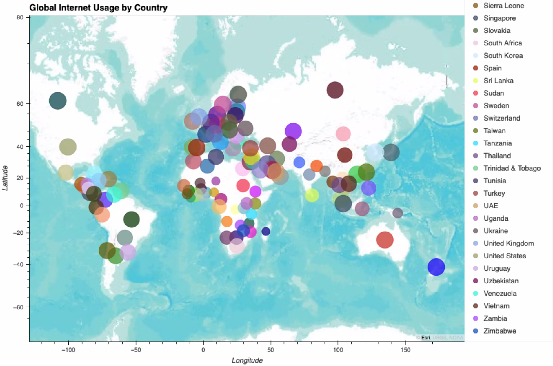
Global Internet Usage by Country - Heatmap

Slide 8
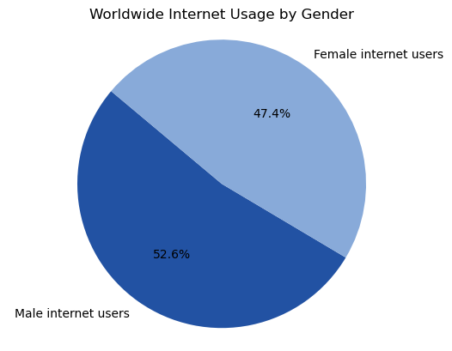
Internet Access - Gender

Slide 9
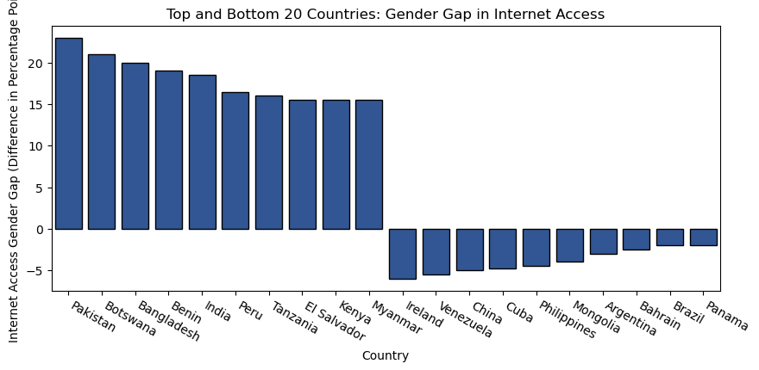
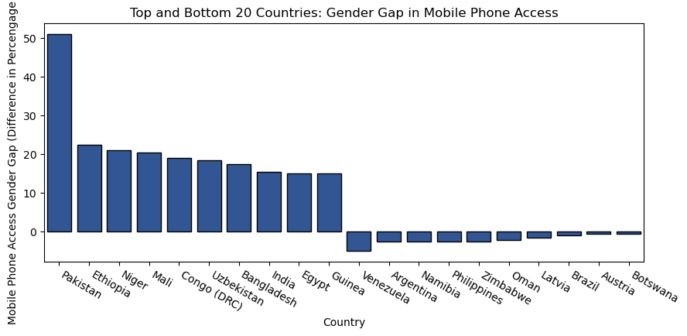
Internet Access - Gender Gaps

Slide 10
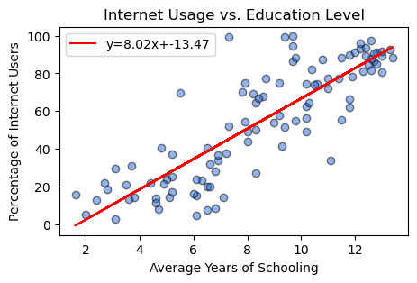
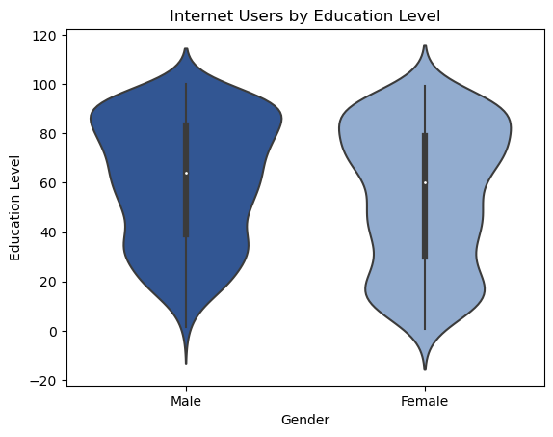
Internet Access – Education Level
Education Level
As average years of schooling increases, percentage of users also increases.
Education level and internet usage are positively correlated – the more educated people are, the more they use the internet.
Internet Users by Education and Gender
There is a large presence of less educated female users.
Male usage increases as education level increases.

Slide 11
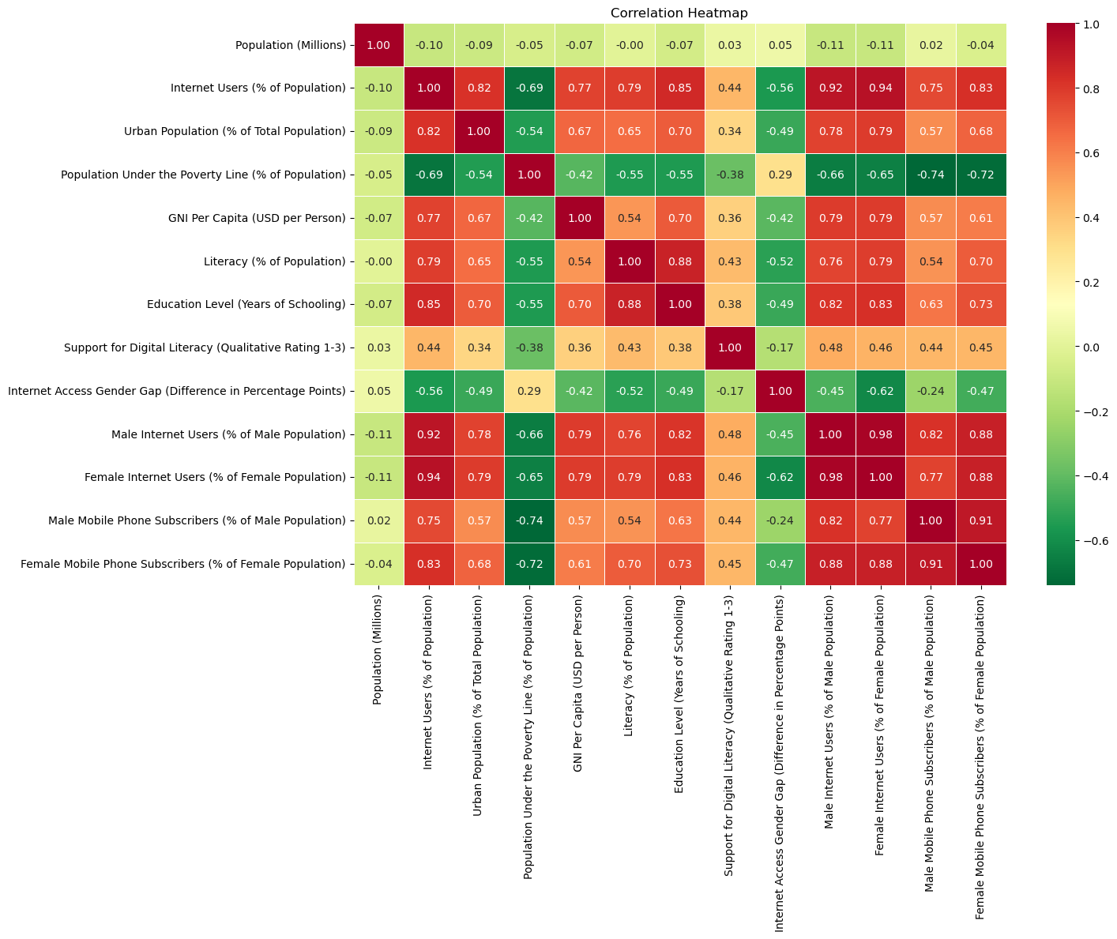
Internet Access – Correlation Heatmap

Slide 12
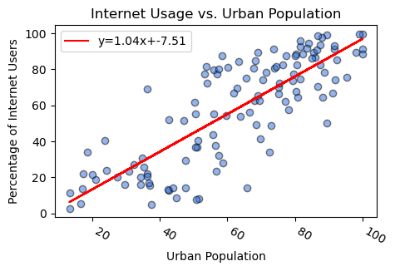
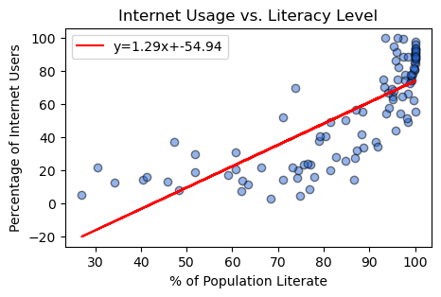
Internet Access – Urban Population & Literacy
Urban Population
Positive correlation between increase in urban population and internet users; usage remains evenly distributed throughout.
Literacy Level
Exponential increase in internet usage per literacy rate increase, especially above 90% range.

Slide 13
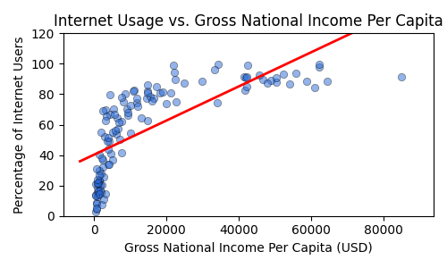
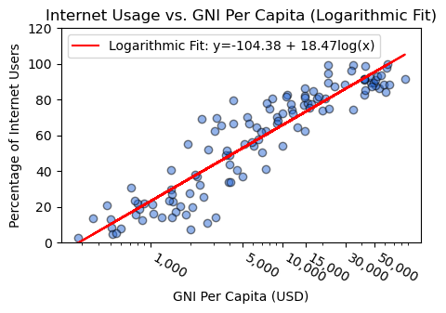
Internet Access – Gross National Income
GNI
Logarithmic increase in internet usage when placed against GNI per capita; this is the opposite of an exponential increase.
GNI (Log)
Plotting the data on a logarithmic scale helps us to better visualize the information and the way internet usage increase per GNI/capita.

Slide 14
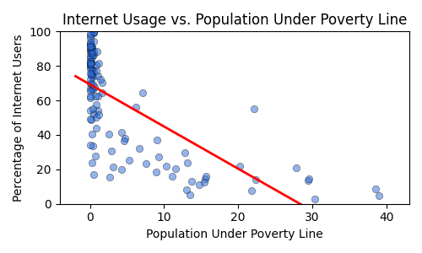
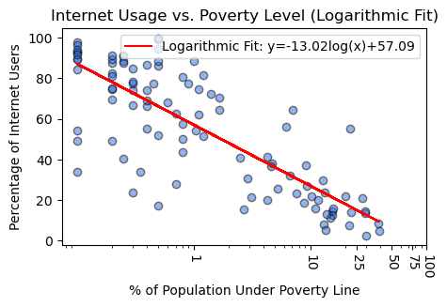
Internet Access – Poverty Level
Population Under Poverty
Internet usage vs population under the poverty line also appears to show a slightly logarithmic correlation, with higher usage very tightly centered around higher populations.
Population Under Poverty (Log)
We graphed this data on both a linear and logarithmic scale, as well, to help visualize the data.

Slide 15
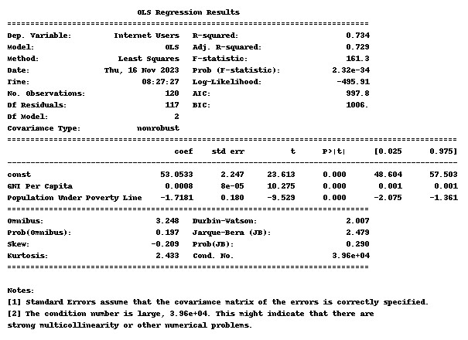
Ordinary Least Squares/ Multilinear Regression Analysis

Slide 16
Impact of Internet Technology
Broadband V. Mobile
· Davin Frankosky
· Tia Scott

Slide 17
Research Questions
Question 2
What differences are between broadband and mobile usage?
Who is predominantly using broadband and mobile?
What are some of the disparities between broadband or mobile use?

Slide 18
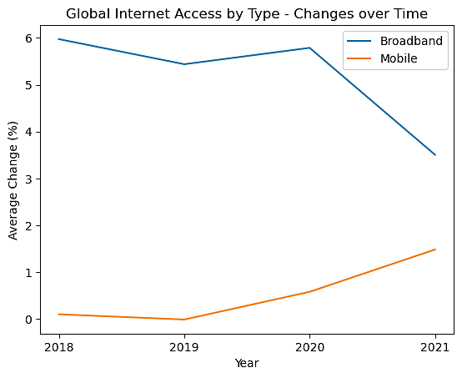
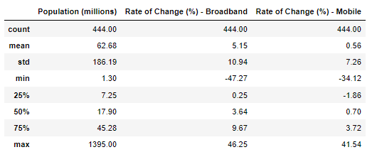
Broadband v. Mobile – Change Over Time
Global Internet Access By Type
Both access types are increasing yearly
Growth in mobile is accelerating
Growth in broadband is decelerating
Could these be correlated?

Slide 19
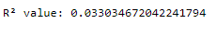
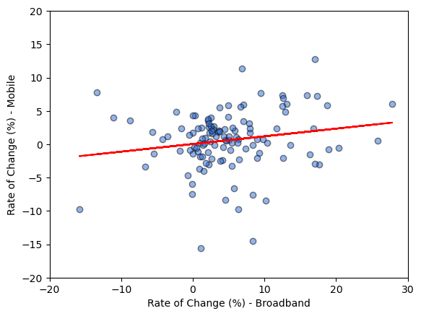
Broadband v. Mobile– Change Over Time Correlation Check
T-Test Results – Rate of Change of Broadband V. Mobile
Globally, these are NOT correlated!
Other Non-Correlations
Specific years
Rural V. Urban Populations
Availability of electricity
Maybe regional differences are significant?

Slide 20
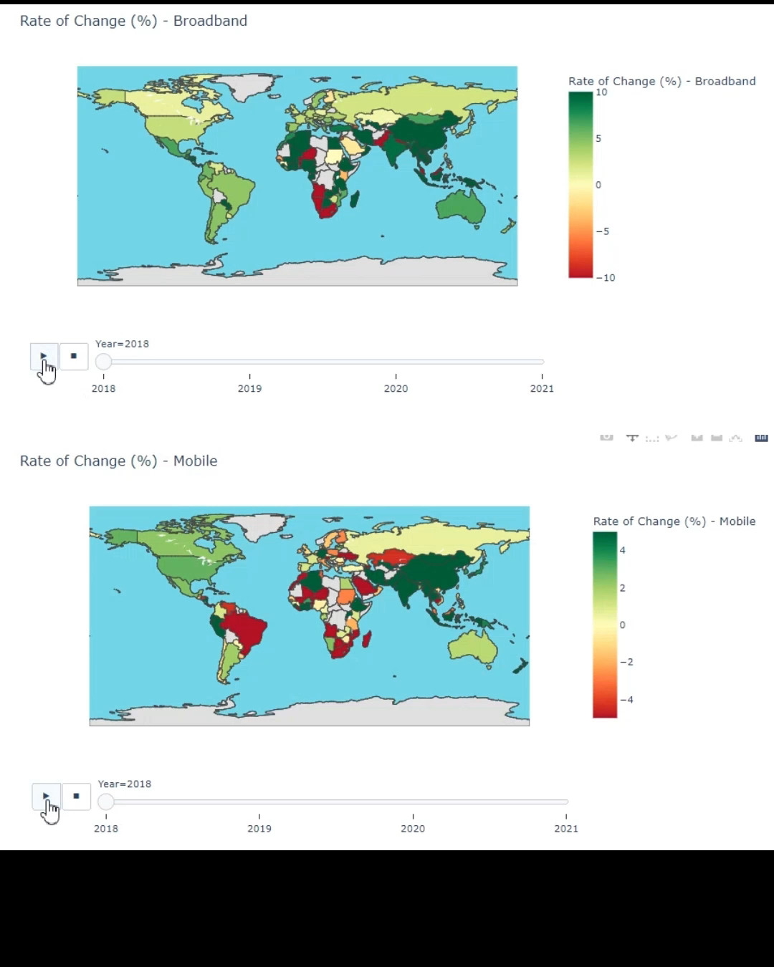
Broadband v. Mobile – Regional Heatmap
Heatmap Results
Regional differences look like they could be significant compared to the global average.
Let’s dig in deeper to South America.

Slide 21
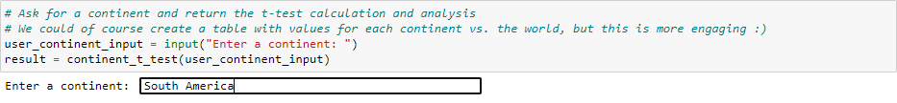
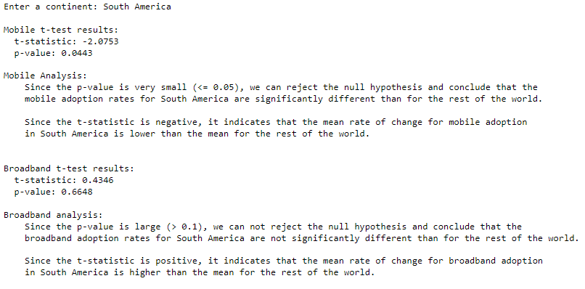
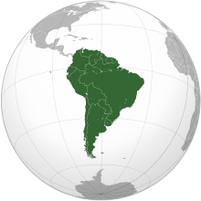
Broadband v. Mobile – Change Over Time Correlation Check
Correlation Results
Confirmation that specific regions have significant differences in certain types of access.
South America shows a significant decline in mobile internet adoption.
NOT correlated to a rise in broadband adoption.

Slide 22
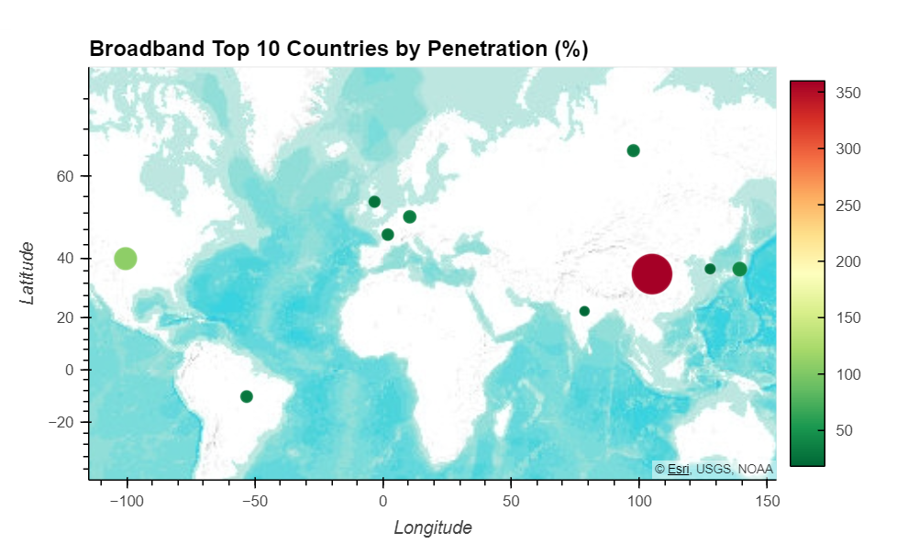
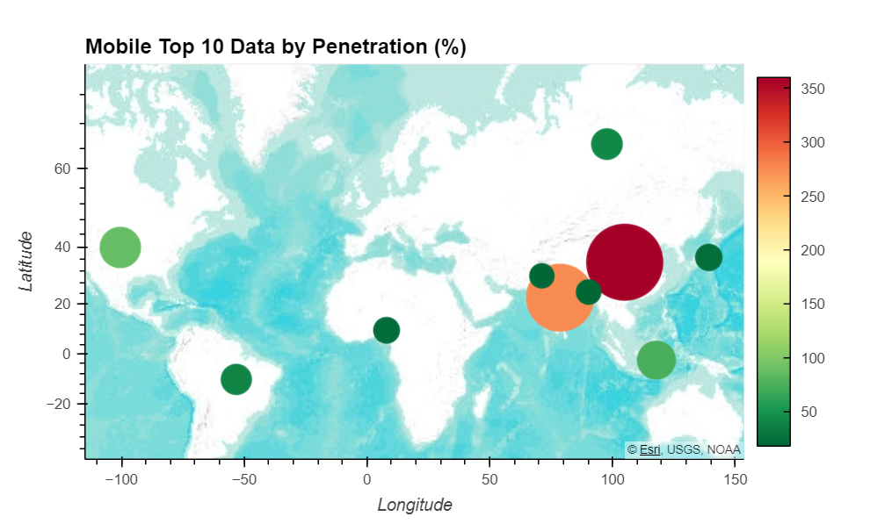
Broadband v. Mobile – Heatmap
Heatmap Results
China leads the way for both broadband and mobile Service.
Globally, mobile penetration is much higher than broadband, visually, almost double.
Europe has more broadband adoption and Asia and Africa more mobile adoption.

Slide 23
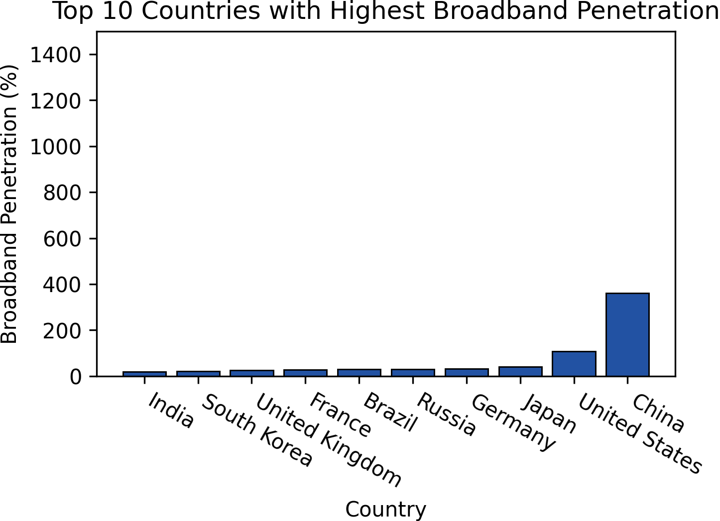
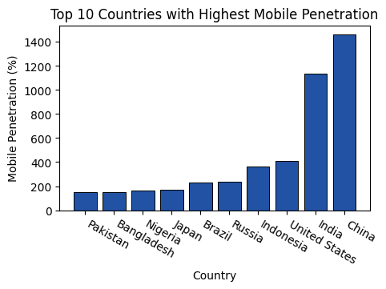
Broadband v. Mobile – Top 10 Countries
Broadband Penetration (%)
China leads the way.
Other well-known internet-heavy, high-usage countries – U.S., Japan, Russia, Brazil, South Korea, India.
Mobile Penetration (%)
China remains in first place.
Surprising is the change in India from last in broadband to second in mobile.

Slide 24
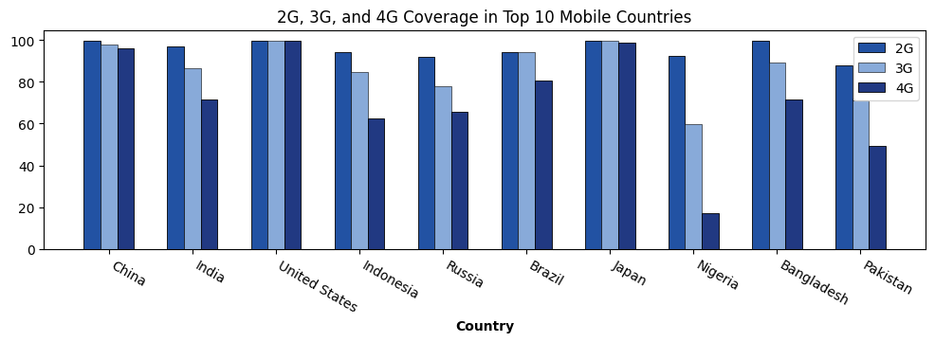
Broadband v. Mobile – Coverage
Top 10 Countries Mobile Coverage
2G (Basic cell coverage, SMS/MMS, 64Kpbs) is high in all countries.
3G (Entertainment/Data Transfer, HSPA+, 8Mbps), on average 10-15% less available than basic service.
4G (High Speed, AdHoc/Multi-Hop, 50Mbps), over 50% availability is all countries, barring Nigeria.
Notes:
HSPA – High Speed Packet Access

Slide 25
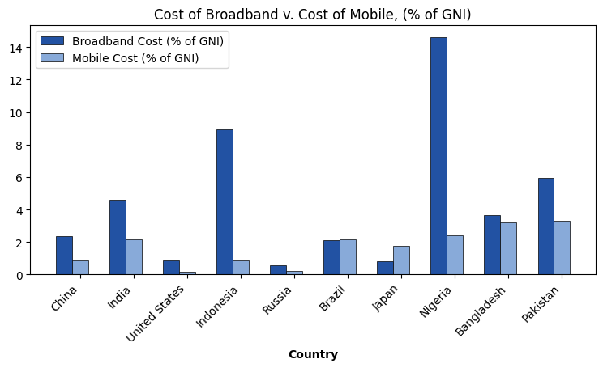
Broadband v. Mobile – Cost Comparison
Top 10 Mobile Countries - Cost Comparisons
Mobile-heavy countries see broadband rates double (on-average) compared to mobile cost.
India (ranked last in broadband), sees the same trend.
In Indonesia and Nigeria it is most likely cost-prohibitive to operate broadband.

Slide 26
Impact of Internet Censorship
· George Liberatos
· Haylee McLean

Slide 27
Research Questions
Question 3
Who is censoring the internet to users?
What countries are affected the most by internet censorship?
When looking at censorship globally, who is being censored?

Slide 28


Slide 29
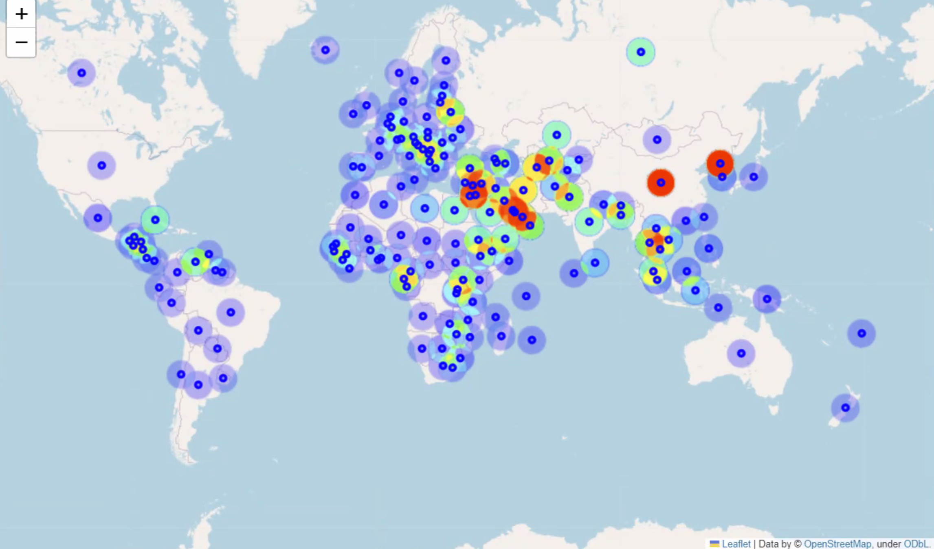
Internet Censorship - Heatmap
Censorship Across the World
Censorship scores range from 1 to 11. (1 being the least restricted and 11 being the most restricted.)
Warmer shades such as red to signify higher levels of scores in specific areas
Notes:
This map includes a heatmap layer that visualizes data distribution across various geographic regions. The color scheme employs warmer shades such as red and orange to signify higher levels of scores in specific areas. These scores range from 1, indicating minimal restrictions, to 11, signifying the highest level of restrictions. Upon examining the plotted data, it becomes evident that Asia and the Middle East exhibit notably high levels of internet usage restrictions.

Slide 30
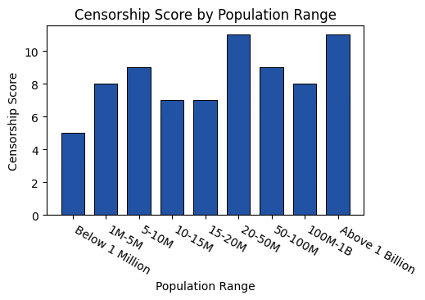
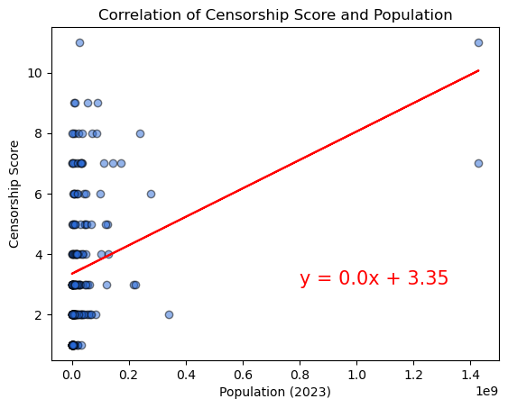
Internet Censorship – Score and Population
Population and Censorship
Taking a deeper look into the country’s population against their censorship score there may be a correlation between high populations and high scores.
Population and Censorship Correlation Test
Tested on a scatter plot ultimately there is little to no correlation between the two.

Slide 31
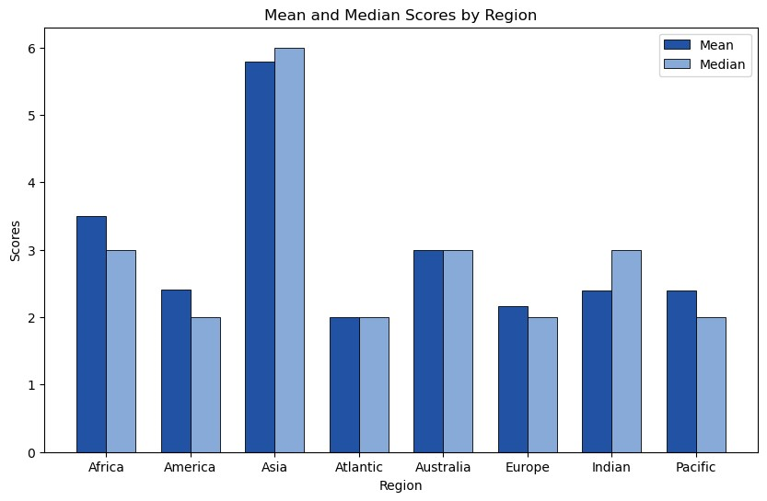
Internet Censorship – Mean and Median
Censorship Across the World
Censorship scores range from 1 to 11. (1 being the least restricted and 11 being the most restricted.)
Warmer shades such as red to signify higher levels of scores in specific areas

Slide 32
Conclusion

Slide 33

Conclusions
QUESTION | SHORT ANALYSIS
Who is using the internet? | Males People with higher incomes People who are more educated
INTERNET DEMOGRAPHICS
QUESTION | SHORT ANALYSIS
Are broadband and mobile adoption rates correlated? | While initially it looks like broadband is decelerating in adoption globally while mobile is accelerating, these changes over time are not actually correlated. However, investigating by region (continent), we find significant differences for certain parts of the world.
Who is prevailing in broadband and mobile usage? | China is both the top country in both Broadband and Mobile adoption. China’s aggregate is around 200% more penetration than the next lowest country in both categories.
What are the cost disparities between Broadband and Mobile? | Mobile is clearly more cost-effective compared to broadband. In countries such as Indonesia and Nigeria it is clearly cost prohibitive to have broadband access versus mobile phones.
BROADBAND V. MOBILE
QUESTION | SHORT ANALYSIS
Who is censoring the internet to users? | The main two countries with the most restricted internet usage to users were China and North Korea.
What countries are affected the most by internet censorship? | Countries within the Asian region are the most heavily censored. Leading to potentially misinformation or information not able to get to those users.
When looking at censorship globally, who is being censored? | From the countries assessed all had at least a censorship score of 1, meaning there is some level of restriction on the internet in any country.
INTERNET CENSORSHIP

Slide 34
Appendix

Slide 35

Timeline
CSV RESOURCES
API RESOURCES
MERGE
FILE CREATION
Identify and collect data from CSV’s
Identify and collect data from CSV’s
Merge data into master dataframes
Create files with merged data
Intake
Cleaning
Join
Explore
CONVERT
REFINE
EXPLORE
Normalize data
into usable
datasets
Fill NaN’s, empty data, parse bad data
Test relationships, theories, and create compelling visuals
Notes:
Cross-section between Tech and Ops

Slide 36
Data Sources
Kaggle
Internet Usage – History of Internet and Evolution of Broadband
https://www.kaggle.com/datasets/pavan9065/internet-usage?select=broadband-penetration-by-country.csvSub Bullet
Comparitech
Internet Censorship 2023: A Global Map of Internet Restrictions
https://www.comparitech.com/blog/vpn-privacy/internet-censorship-map/
United Nations
Department of Economic and Social Affairs : Population Division
https://population.un.org/wpp/
GeoAPIfy
GeoAPIfy – Location API
https://www.geoapify.com/
Our World In Data
Gender Ratios
https://ourworldindata.org/gender-ratio#gender-ratio-across-the-world/
General
https://chat.openai.com/
https://geekforgeeks.com/
https://stackoverflow.com/
https://plotly.com/

